Slide 1
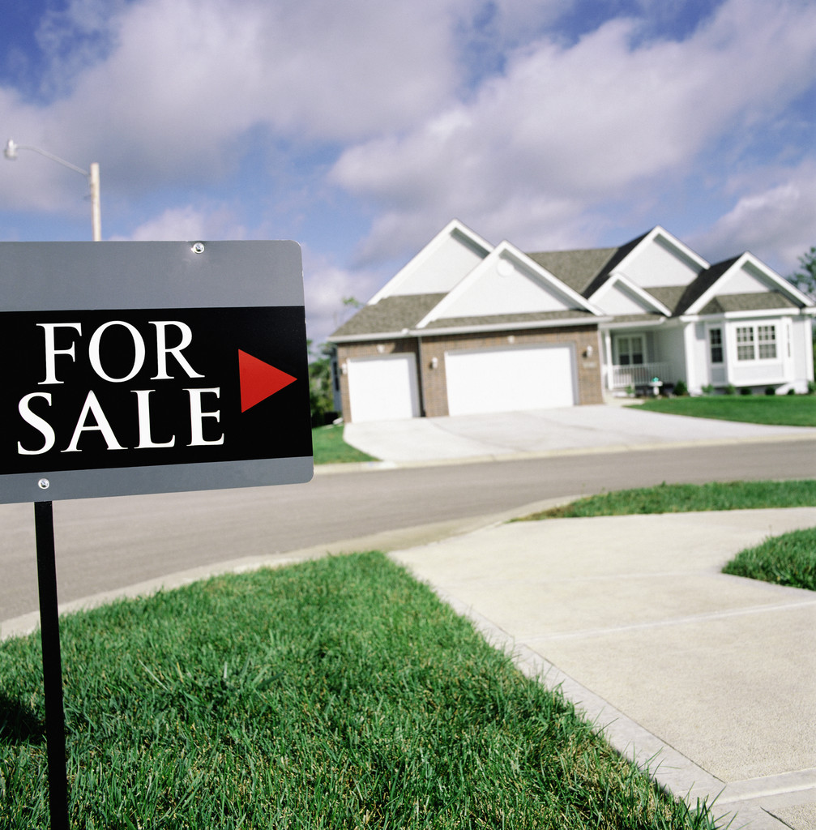
Respect for PUBLIC

Slide 2
RESPECT FOR PUBLIC
Educate clients
Set expectations
Notes:
2
Many difficult situations can be avoided by simply educating your clients. It is appropriate for agents to set clear expectations during the first appointment with prospects and/or clients. Discuss what clients can expect from you and what you, in turn, will expect from them. It is better to find out in the beginning that clients have unrealistic expectations than to find out later when they become angry about something you did or did not do.

Slide 3
RESPECT FOR PUBLIC
Identify Realtor® status and company affiliation
Show courtesy and respect
Respect differences
Maintain confidentiality
Notes:
3
Realtors® should always identify their Realtor® status and company affiliation at first contact with members of the public.
Show courtesy and respect to everyone.
Be aware of and respect cultural differences.
Do not disclose confidential information about your client. Do not mislead or speculate with prospective buyers about the sellers’ financial situation or their motivation for selling. Avoid giving too much information to the listing agent or seller regarding the buyers’ interest, motivation or ability to pay more than they are willing to offer.

Slide 4
Respect For Public COMMUNICATION
Respond promptly
Communicate clearly
Be responsible – have integrity
Under promise, over deliver
Direct questions to the appropriate party
Notes:
4
One of the biggest complaints buyers and sellers express about real estate agents has to do with communication – or the lack thereof. Agents should respond promptly to inquiries and requests for information, and maintain regular communication with clients.
Communicate clearly. Avoid jargon or slang that might not be readily understood or appreciated. Take the time to ensure the other person understands what you are trying to say.
Do what you say you will do when you say you will do it. Mark deadlines on your calendar and flag them to remind you ahead of time.
Do not tell people what you think; tell them what you know. It is far better to tell someone that you don’t have an answer, but will get an answer than to try to bluff through an answer.
When other agents’ clients ask you questions, instead of answering as you would for your clients, direct them to the agent who represents them.

Slide 5
Respect For Public PROFESSIONALISM
Professional attire
Appropriate attitude
Clean car
Notes:
5
Realtors® should present a professional appearance at all times. Dress appropriately – as well as or better than your client. Keep your relationships with clients strictly professional.
When working with a couple, be sure to give both individuals equal attention. Do not direct all information to one individual over another. You may alienate one of them by doing this.
Always keep your car clean so that if you have an unexpected appointment, it will reflect well on you.

Slide 6
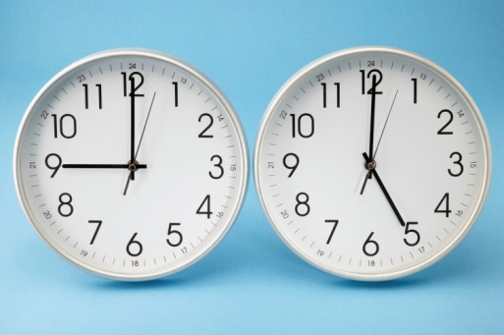
Respect For Public APPOINTMENTS
Schedule appointments as far in advance as possible
Sundays and holidays
Schedule second showings through CSS
Plan time wisely
Be punctual
Cancellations
Previews and inspections
Notes:
Schedule appointments and showings as far in advance as possible, including those for new construction. Make appointments for Sunday mornings and holidays well in advance to avoid interrupting the sellers’ schedule more than necessary. Make every effort to schedule appointments during business hours.
Call Centralized Showing Service to schedule all second showings – even if it is on the same day or during the same scheduled showing period. Sellers frequently return after they know you are gone. Do not take a chance on surprising an unsuspecting seller.
Space your appointments to allow enough time to show each listing and make it to your next appointment on time. Explain to your buyers that appointments are a required courtesy to sellers – whether the house is vacant or occupied.
Be punctual. If you are unable to arrive during the scheduled appointment time, call CSS to change the time or cancel the appointment.
If a buyer decides to not view a home, contact CSS immediately to cancel the showing.
Never show a listed property without an appointment.
These courtesies apply to previews and inspections in addition to showings.

Slide 7
RESPECT FOR PUBLIC
Unexpected situations – “The unexpected”
The seller
Lock up?
Bathroom break!
Avoid criticism
Notes:
7
Always ring the doorbell or knock – and announce yourself loudly – before entering a home, even if it is vacant. Knock and announce yourself before opening a closed door.
When entering a property, ensure that unexpected situations, such as pets, are handled appropriately.
Whenever possible, the listing agent should advise the seller to leave the property during showings to give the buyer an opportunity to imagine the house as his or her home.
If someone is home but leaves when you arrive, ask if he or she wants the house locked when you leave. If a seller remains in the home during the showing, inform the person when you are leaving.
Allow time in your schedule for bathroom breaks. If it is necessary to use a sellers’ bathroom and the sellers or occupants are home during the showing, ask their permission before using their bathroom. Do not ever use bathrooms that have been winterized.
Never criticize property in the presence of the owner or occupant.

Slide 8
RESPECT FOR PUBLIC
Business card etiquette
Do not leave notes
Always provide feedback
Listing agent
Even if not requested
CSS
By end of day
Notes:
Leave your business card only if the property is occupied. Do not ever leave a personal brochure or any other type of promotional material when showing property.
Do not write notes to the sellers of properties that you show.
Be aware that sellers might have direct access to your feedback. If a seller contacts you directly for feedback, refer them to the listing agent. Avoid getting into a conversation with the seller about the pros and cons of his or her house.
It is appropriate to send feedback even if you have not received a request.
For showings made through Centralized Showing Service, simply complete the online feedback request. Do not include any contact information except for a first name as feedback may be viewed by the seller.
For showings not scheduled through CSS, send an e-mail to the listing agent thanking him or her for the showing and giving any appropriate feedback.
Always respond to feedback requests even if it is nothing more than “Sorry, they were not interested.”
It is best to send feedback for the properties you showed by the end of the day while the information is still fresh in your mind. If you wait, you won’t remember the property as well and your feedback will not be as valuable.

Slide 9
RESPECT FOR PUBLIC
Discussion Questions
What attire is appropriate when showing property?
Remember your shoes
Review firm’s policy
Notes:
9
When showing property, remember that you are not only dressing to be with your buyers, you might also meet the seller. You certainly would want to make a favorable first impression so that any future negotiations will be easier.
Keep in mind that some sellers will request that you remove your shoes. You might want to wear shoes that are easily removed. Also remember that you might be walking around the house to find the lockbox. High heels might cause a turned ankle.
NOTE: This is a good time to review your firm’s policy about your dress code.

Slide 10
RESPECT FOR PUBLIC
Discussion Questions
When another agent’s client contacts you, how do you respond?
Feedback to listing agent
Notify other agent and your BIC in writing
Notes:
10
If a seller contacts you directly for feedback, tell him or her that you will – or already have – given your feedback to the listing agent. Avoid conversations about the sellers’ property or your buyers’ impressions.
If a buyer or seller contacts you during negotiations or while under contract, advise him or her to call his or her agent. Then notify the other agent and your broker-in-charge in writing that the client has contacted you. Remember to put a note or copy of your notice in your file in case there is a need for it in the future.

